Slide 1
Linux on Raspberry Pi
Raspberry Pi Interfaces

Slide 2
What is an IoT Device?
A "Thing" in Internet of Things (IoT) can be any object that has a unique identiﬁer and which can send/receive data (including user data) over a network (e.g., smart phone, smart TV, computer, refrigerator, car, etc. ).
IoT devices are connected to the Internet and send information about themselves or about their surroundings (e.g., information sensed by the connected sensors) over a network (to other devices or servers/storage) or allow actuation upon the physical entities/environment around them remotely.

Slide 3
Basic Building Blocks of an IoT Device
Sensing
Sensors can be either on-board the IoT device or attached to the device.
Actuation
IoT devices can have various types of actuators attached that allow actions to be performed upon the physical entities in the vicinity of the device.
Communication
Communication modules are responsible for sending the collected data to other devices or cloud-based servers/storage and receiving data from other devices and commands from remote applications.
Analysis and Processing
Analysis and processing modules are responsible for making sense of the collected data.

Slide 4
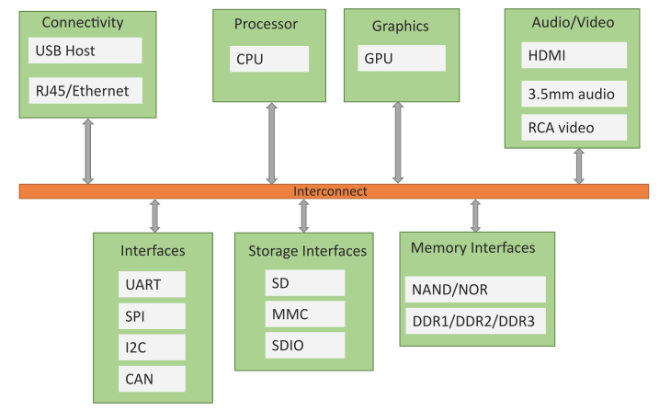
Block Diagram of an IoT Device

Slide 5
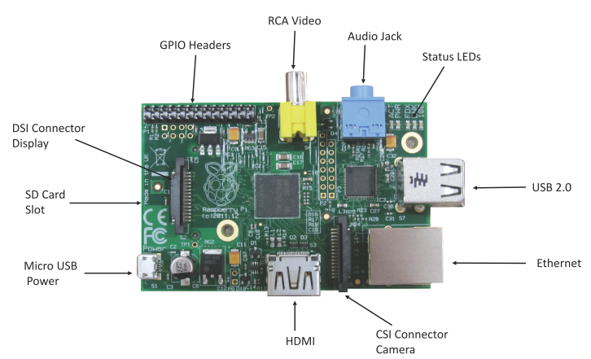
Raspberry Pi

Slide 6
Linux on Raspberry Pi
Raspbian
Raspbian Linux is a Debian Wheezy port optimized for Raspberry Pi.
Arch
Arch is an Arch Linux port for AMD devices.
Pidora
Pidora Linux is a Fedora Linux optimized for Raspberry Pi.
RaspBMC
RaspBMC is an XBMC media-center distribution for Raspberry Pi.
OpenELEC
OpenELEC is a fast and user-friendly XBMC media-center distribution.
RISC OS
RISC OS is a very fast and compact operating system.

Slide 7
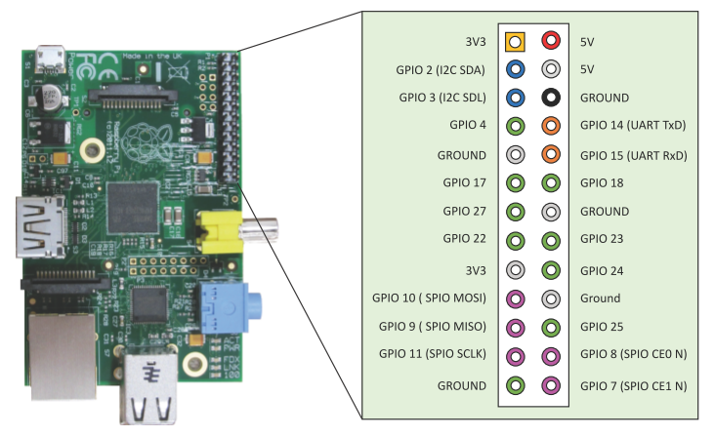
Raspberry Pi GPIO

Slide 8
Raspberry Pi Interfaces
Serial
The serial interface on Raspberry Pi has receive (Rx) and transmit (Tx) pins for communication with serial peripherals.
SPI
Serial Peripheral Interface (SPI) is a synchronous serial data protocol used for communicating with one or more peripheral devices.
I2C
The I2C interface pins on Raspberry Pi allow you to connect hardware modules. I2C interface allows synchronous data transfer with just two pins – SDA (data line) and SCL (clock line).

Slide 9
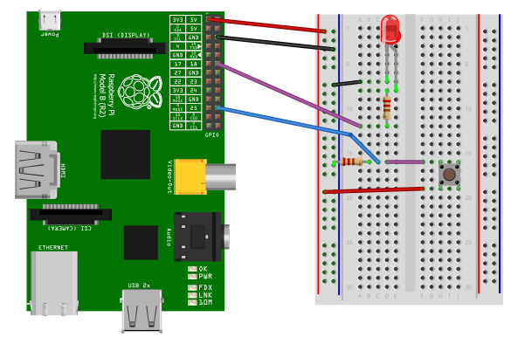
Raspberry Pi Example: Interfacing LED and Switch with Raspberry Pi
from time import sleep
import RPi.GPIO as GPIO
GPIO.setmode(GPIO.BCM)
#Switch Pin
GPIO.setup(25, GPIO.IN)
#LED Pin
GPIO.setup(18, GPIO.OUT)
state=false
def toggleLED(pin):
state = not state
GPIO.output(pin, state)
while True:
try:
if (GPIO.input(25) == True):
toggleLED(pin)
sleep(.01)
except KeyboardInterrupt:
exit()

Slide 10
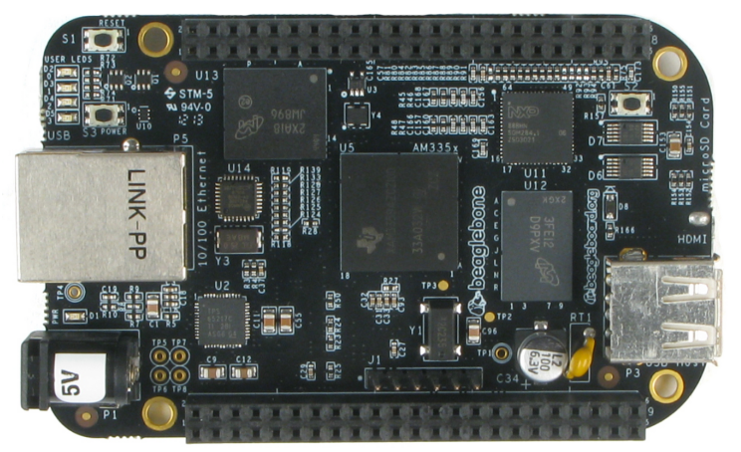
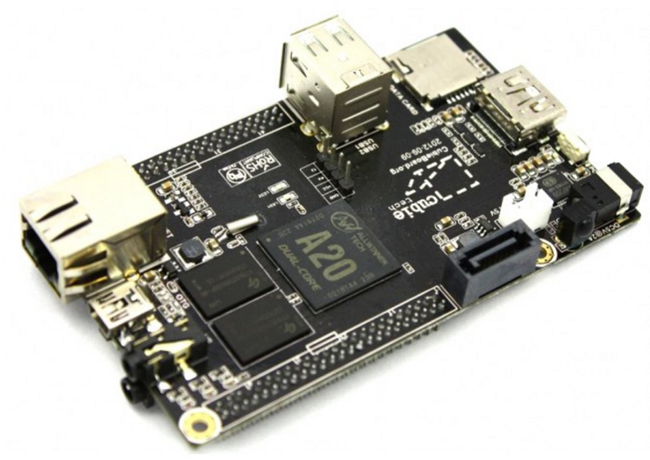
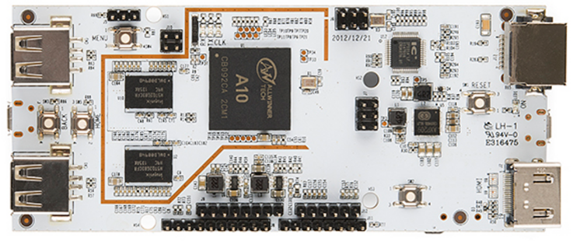
Other Devices
pcDuino
BeagleBone Black
CubieBoard

